Slide 1

An Evergreen Planet: Preserving our World’s Natural Forests
Kevin Huang Christine Zhang Jesse Zhang

Slide 2
Idea: Deforestation
Forests produce essential oxygen, materials, and habitat for the survival of species on Earth.
Between 2000 and 2012, only 2.4 million square miles of the original 6 million square miles of forest covering the Earth remain.
Many functions of forests have no apparent economic value to their owners, and so they are quickly converted for profit.

Slide 3
Goals
Raise awareness of deforestation and its alarming rates in different regions of the world
Present viewers with important information different time periods, geographic regions, and socioeconomic levels to send message
Discover trends to determine where to focus in order to have the most impact
Provide a clean and elegant design

Slide 4
Tasks
Individually focus on creating own visualizations first (1 for each person)
Merge codes together on Github and make sure there are no compatibility issues
Factorize overlapping functions used in separate visualizations
Create website template and containers
Insert visualizations and text information into the already created containers
Stylize the website using CSS
Optimize efficiency of visualization generation
Add additional visualizations as needed
Fix any outstanding bugs
Get feedback from peers
Implement advice given by peers
Finalize website design

Slide 5
Data
The World Bank dataset consists of annual data from 1990 to 2015 of the percentage of forested land broken down by countries, continents, and socioeconomic levels.
The Mongabay dataset covers gross forest loss to measure the rate of deforestation.

Slide 6
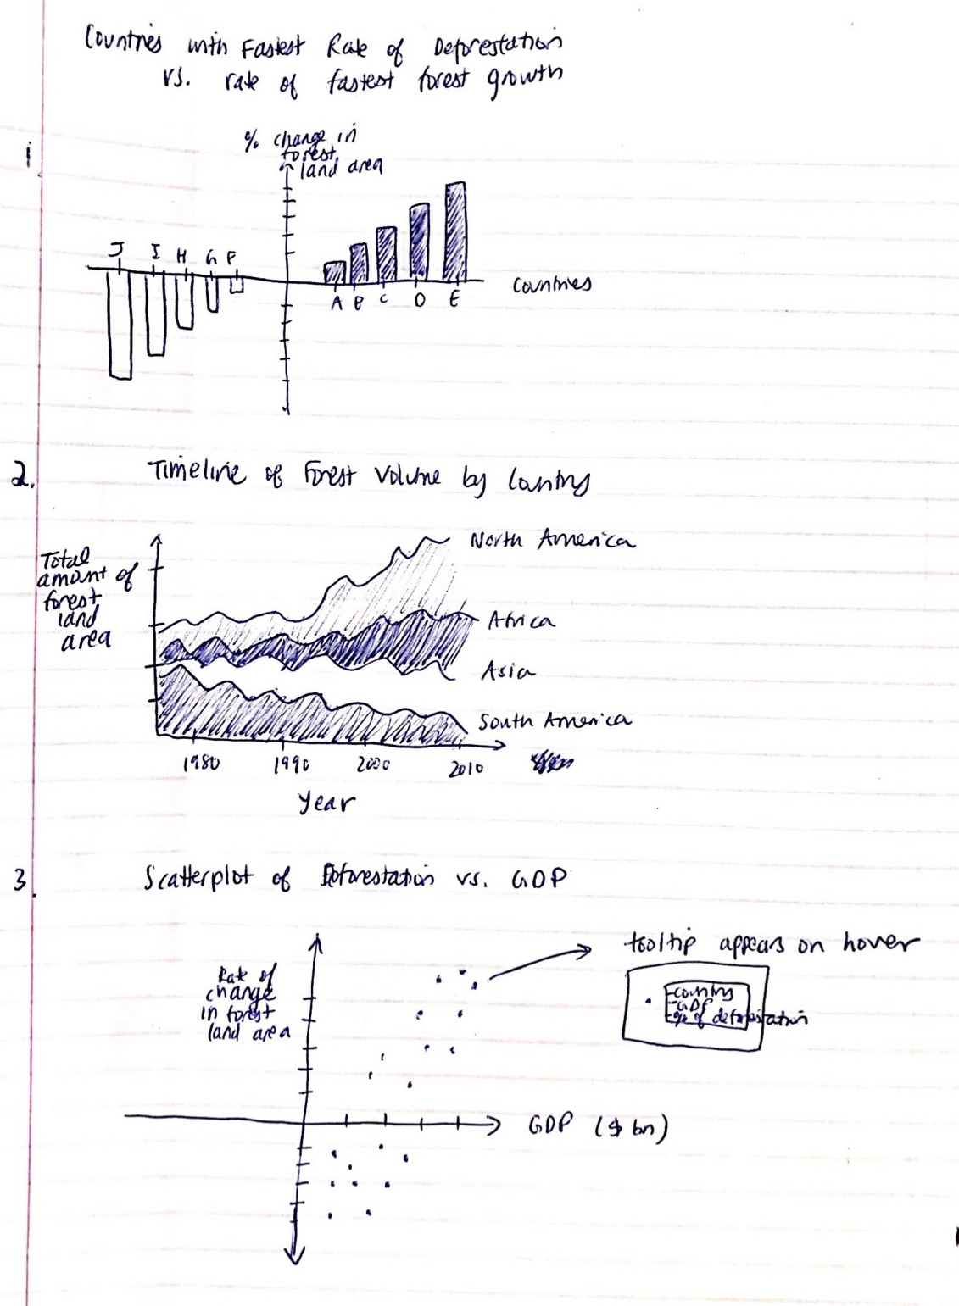
Sketch 1

Slide 7
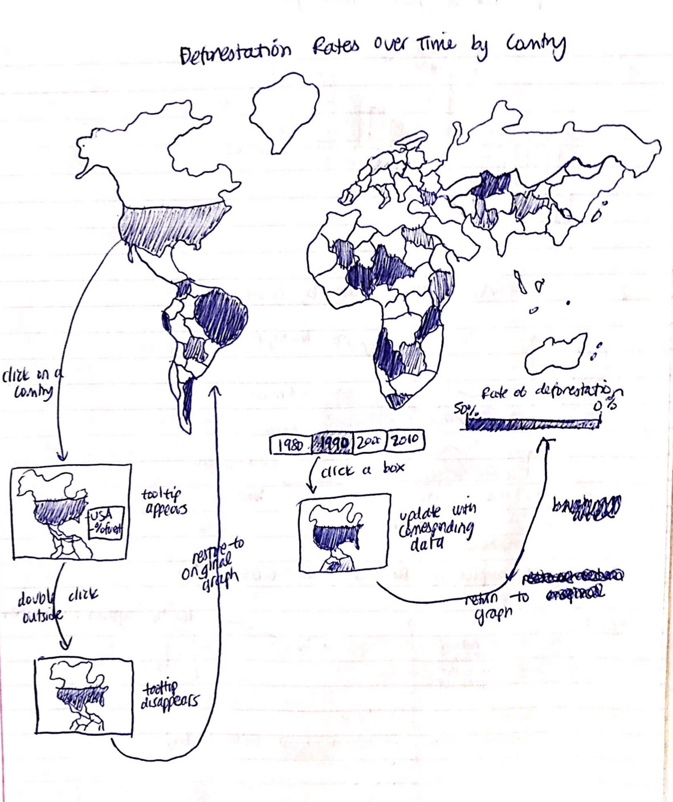
Sketch 2

Slide 8
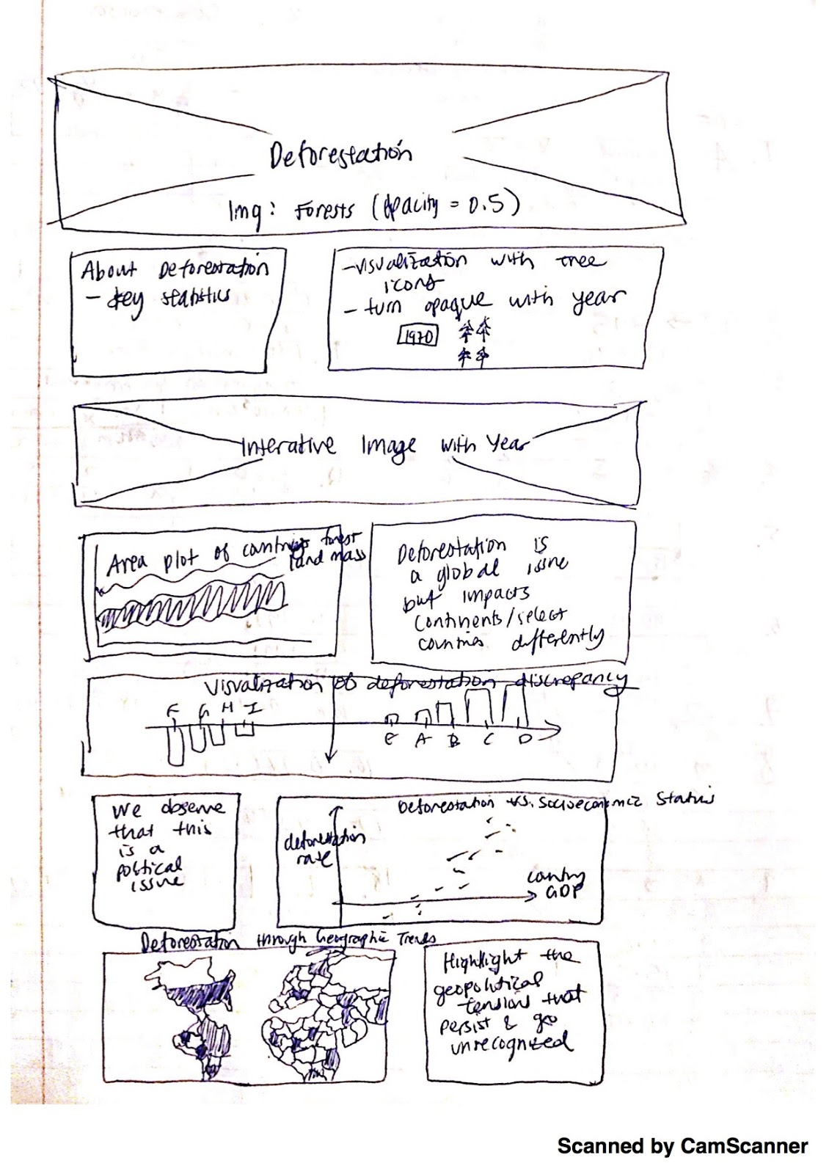
Sketch 3

